Slide 1

RFID SENSOR
AKSHAYA(236)
ANUSHA(232)
GOWTHAM(234)
SHANMUKH(235)
KARTHIK(237)

Slide 2
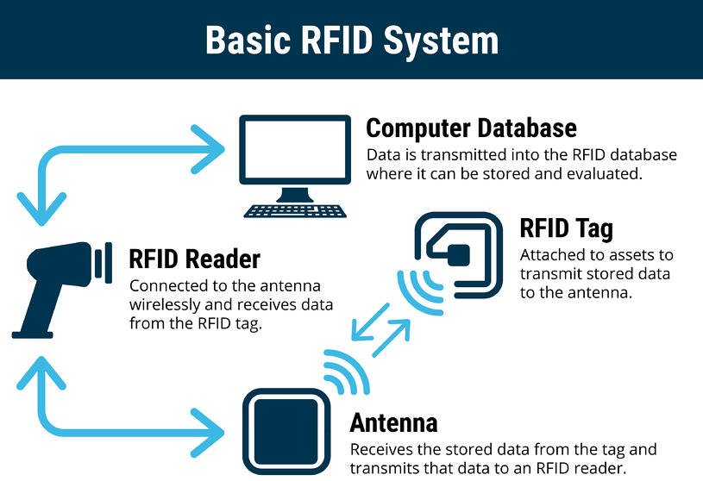
What is rfid?
RFID is a Radio Frequency Identification.
An RFID systems consists of a tiny radio transponder, a ratio receiver and transmitter.
It is a form of wireless communication that incorporates the use of electromagnetic or electrostatic coupling in the ratio frequency portion of electromagnetic spectrum to identify an object, animal or person.

Slide 3
How does it work?
Every RFID system consists of three components: a scanning antenna, a transceiver and a transponder.
It uses radio waves to transmit signals that activate the tag. Once activated, the tag sends a wave back to the antenna, where it is translated into data. The transponder is in the RFID tag itself.

Slide 4
Merits
Scanning Range. An RFID reader can scan a tag as long as it is within frequency range.
RFID Capabilities. RFID systems can scan multiple items simultaneously. ...
Speed and Convenience.
RFID Costs.
Scanning Issues.
RFID Security and Privacy Concerns.

Slide 5
De-merits
Materials like metal & liquid can impact signal.
Sometimes not as accurate or reliable as barcode scanners.
Cost – RFID readers can be 10x more expensive than barcode readers.
Implementation can be difficult & time consuming

Slide 6
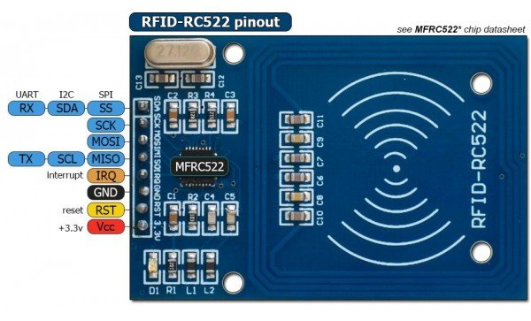
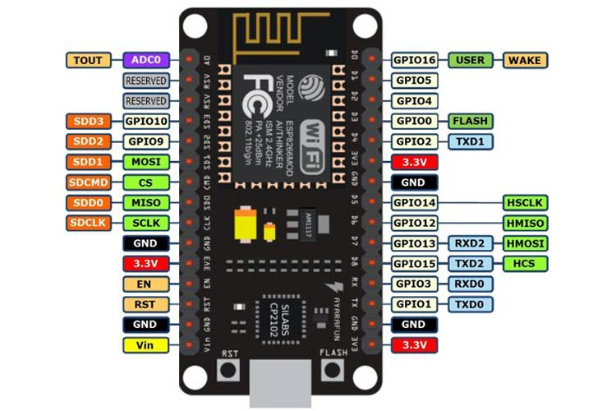
project components
RFID Sensor
Node MCU (ESP8266)
Jumper wires
9V Battery
LED

Slide 7
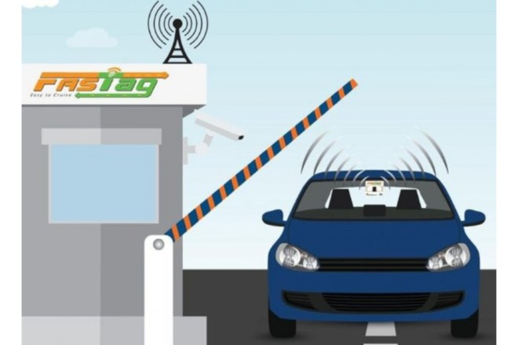
working
RFID sensor uses to identify the ID-Card
Node MCU is a micro-controller. It can connect objects and let data transfer using the Wi-Fi protocol
MAIN USAGE:
Radio Frequency Identification (RFID) technology is at the core of FASTag

Slide 8
code
#include <SPI.h>
#include <MFRC522.h>
constexpr uint8_t RST_PIN = D3; // Configurable, see typical pin layout above
constexpr uint8_t SS_PIN = D4; // Configurable, see typical pin layout above
MFRC522 rfid(SS_PIN, RST_PIN); // Instance of the class
MFRC522::MIFARE_Key key;
String tag;

Slide 9
void setup() {
Serial.begin(9600);
SPI.begin(); // Init SPI bus
rfid.PCD_Init(); // Init MFRC522 }
void loop() {
if ( ! rfid.PICC_IsNewCardPresent())
return;
if (rfid.PICC_ReadCardSerial()) {
for (byte i = 0; i < 4; i++) {
tag += rfid.uid.uidByte[i]; }
Serial.println(tag);
tag = "";
rfid.PICC_HaltA();
rfid.PCD_StopCrypto1();
}}

